Slide 1

Software Requirement Engineering
Requirements Analysts – Knowledge, Skills and Tasks
Week # 5

Slide 2
The Business Analyst
The requirement analyst is the individual who has the primary responsibility to elicit, analyze, document, and validate the needs of the project stakeholders.
The analyst serves as the principal interpreter through which requirements flow between the customer community and the software development team
The BA plays a central role in collecting and disseminating product information, whereas the project manager takes the lead in communicating project information.

Slide 4
The Business Analyst
A talented analyst can make the difference between a project that succeeds and one that struggles. One company discovered that they could inspect requirements specifications written by experienced analysts twice as fast as those written by novices because they contained fewer defects.
Using highly experienced analysts can reduce the project’s overall effort by one-third compared to similar projects with inexperienced analysts.

Slide 5
The Business Analyst’s Tasks
Following are the some of the typical activities that you might perform while wearing an analyst’s hat.
Define business requirements Your work as a BA begins when you help the business or funding sponsor, product manager, or marketing manager define the project’s business requirements.
Plan the requirements approach The analyst should develop plans to elicit, analyze, document, validate, and manage requirements throughout the project.

Slide 6
The Business Analyst’s Tasks
Identify project stakeholders and user classes Work with the business sponsors to select appropriate representatives for each user class
Elicit requirements A proactive analyst helps users articulate the system capabilities they need to meet their business objectives by using a variety of information-gathering techniques.
Analyze requirements Look for derived requirements that are a logical consequence of what the customers requested and for implicit requirements that the customers seem to expect without saying so.

Slide 7
The Business Analyst’s Tasks
Document requirements The analyst is responsible for documenting requirements in a well-organized and well-written manner.
Communicate requirements You must communicate the requirements effectively and efficiently to all parties.
Lead requirements validation The BA must ensure that requirement statements possess the desired characteristics and that a solution based on the requirements will satisfy stakeholder needs.

Slide 8
The Business Analyst’s Tasks
Facilitate requirements prioritization The analyst brokers collaboration and negotiation among the various stakeholders and the developers to ensure that they make sensible priority decisions in alignment with achieving business objectives.
Manage requirements A business analyst is involved throughout the entire software development life cycle, so she should help create, review, and execute the project’s requirements management plan.

Slide 9
The Business Analyst’s Skills
Fundamental:
Listening skills To become proficient at two-way communication, learn how to listen effectively.
Learning skills Analysts must learn new material quickly, whether it is about new requirements approaches or the application domain.
Research A business analyst must dig deep to understand the core problem, look for similar solutions elsewhere, explore approaches and come up with a novel resolution to deal with the problem.

Slide 10
The Business Analyst’s Skills
Problem Solving : Each project in itself is a solution to a problem and BAs frequently find themselves surrounded by different sorts of issues, problems and changes all requiring swift and stable resolution
Communication : Nothing holds more importance than being able to communicate clearly. A business analyst should be expressive and articulate, should be an effective listener and should make sure that the receiver corrects understands what is being communicated.
Management skills : Since a BA juggles various activities throughout the day, he should be able to effectively manage his responsibilities and excel in balancing all the sides of the project. It includes collecting requirements, getting sign-offs, documenting requirements, testing, performing change control, attending meetings, ad-hoc tasks and managing the project as a whole.

Slide 11
The Business Analyst’s Skills
Technical skills
Knowledge of IT BA can’t get away without the basic knowledge of the various areas of the Information Technology space.
Software development understanding the knowledge of development methodologies is one of the key skills for any business analyst to be successful
Domain knowledge A business analyst must have a knowledge of the domain he is working in as it will help him better understand the business case of the project,

Slide 12
The Business Analyst’s Skills
Business analysis skills
Modeling skills Modeling skills Models ranging from the venerable flowchart through structured analysis models to Unified Modeling Language notations should be part of every analyst’s repertoire
Creativity They conceive innovative product capabilities, imagine new markets and business opportunities, and think of ways to surprise and delight their customers.
Analytical skills An effective business analyst can think at both high and low levels of abstraction and knows when to move from one to another

Slide 13
The Business Analyst’s Skills
Leadership skills BA must have the capability to led the team. A strong analyst can influence a group of stakeholders to move in a certain direction
Observational skills By watching a user perform her job or use a current application, a good observer can detect subtleties that the user might not think to mention.
Decision making skills A BA, apart from the project manager, is expected to make many decision himself like controlling changes, deciding the viability of a solution and taking management decisions in the interest of the projects.

Slide 14
The Business Analyst’s Skills
Documentation skills As an analyst, you need to be able to set up an information architecture to support the project information as it grows throughout the project
Interviewing and questioning skills Most requirements input comes through discussions, so the BA must be able to interact with diverse individuals and groups about their needs.

Slide 15
The Business Analyst’s Skills
Other skills
Interpersonal skills

Slide 16
The making of a business analyst
No matter what his background, a creative business analyst can apply it to enhance his effectiveness. The analyst needs to gain the knowledge and skills he is lacking, build on any past experiences, and practice performing the BA tasks to become more proficient. All of these help create the well-rounded BA

Slide 17
The making of a business analyst
The former user
Corporate IT departments often have business analysts who migrated into that role after working on the business side as a user of information systems.
These individuals understand the business and the work environment, so they can easily gain the trust of their former colleagues.
They speak the user’s language, and they know the existing systems and business processes.
Problems
On the downside, former users who are now BAs might know little about software engineering or how to communicate with technical people. If they aren’t familiar with modeling techniques, they will express all information in textual form.
Some former users believe they understand what is needed better than current users do, so they don’t solicit or respect input from those who will actually use the new system.
Recent users can be stuck in the here-and-now of the current ways of working, such that they don’t see opportunities to improve business processes with the help of a new information system. It’s also easy for a former user to think of requirements strictly from a user interface perspective. Focusing on solution ideas can impose unnecessary design constraints and often fails to solve the real problem

Slide 18
The making of a business analyst
The former developer or tester
Project managers who lack a dedicated BA often expect a developer to do the job.
Different skill set required
Little patience with users, focused on glamour of technology.
Good candidates are those who enjoy collaborating with customers.
The developer-turned-analyst might need to learn more about the business domain. Developers will benefit from training and mentoring in the diverse soft skills that the best analysts master.
Testers aren’t commonly asked to perform the analyst role but they have analytical mindset, good at finding gaps in requirements. As with a former developer, a tester will have to learn about good requirements engineering practices. She might also need to become more knowledgeable about the business domain

Slide 19
The making of a business analyst
The former (or concurrent) project manager
Project managers have some of the same skills and domain knowledge required.
Project managers will already be used to working with the appropriate teams, understanding the organization and business domains, and demonstrating strong communication skills.
They will likely be good at listening, negotiation, and facilitation. They should have strong organizational and writing skills as well.
However, the former project manager will have to learn more about requirements engineering practices. Need to focus more on requirement engineering practices rather planning and project management activities
Former project managers must learn to focus on understanding the business needs

Slide 20
The making of a business analyst
The subject matter expert
“SMEs can determine, based on their experience, whether the requirements are reasonable, how they extend the existing system, how the proposed architecture should be designed, and the impacts on users, among other areas.
There are risks here, though, too. The business analyst who is a domain expert might specify the system’s requirements to suit his own preferences, rather than addressing the legitimate needs of the various user classes.
He might have blinders on when thinking about requirements and be less creative in proposing new ideas. SMEs are expert in their understanding of the “as-is” system; they sometimes have diffculty imagining the “to-be” system. It often works better to have a BA from the development team work with the SME, who then serves as a key user representative or product champion.

Slide 21
The making of a business analyst
The rookie
Becoming a business analyst is a good entry point into the information technology arena for someone right out of school or coming from a completely unrelated job.
The new graduate will have little, if any, relevant experience or knowledge. He will likely be hired into the BA role because he demonstrates many of the skills required to be a good analyst.
An advantage of hiring a novice as a BA is that he will have few preconceived notions about how requirements processes should work.
Because he lacks related experience and knowledge, a new graduate will have much to learn about how to execute the BA tasks and the intricacies of the practices. The recent graduate also needs to learn enough about the software development process to understand the challenges that developers, testers, and other team members face so he can collaborate effectively with them.
Mentoring can reduce the learning curve for a novice BA and instill good habits from the outset. No matter what his background, a creative business analyst can apply it to enhance his effectiveness. The analyst needs to gain the knowledge and skills he is lacking, build on any past experiences, and practice performing the BA tasks to become more proficient. All of these help create the well-rounded BA

Slide 22
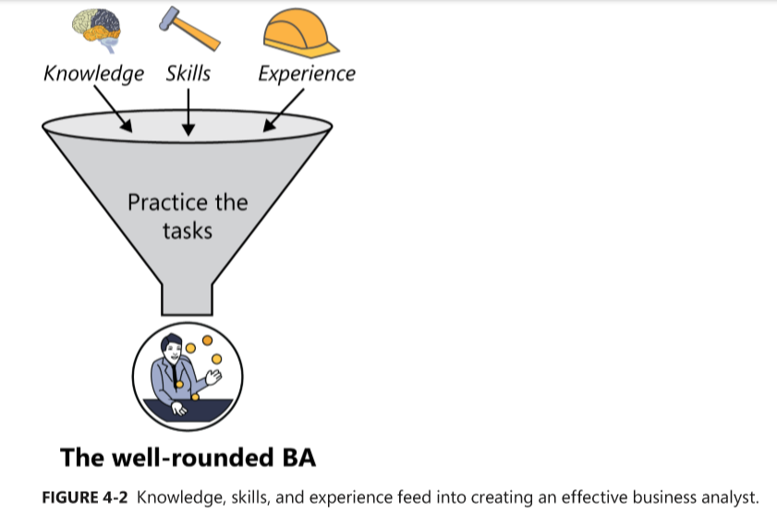
The making of a business analyst

